Slide 1
Animal Shelter home
Presenters : Kartik Chawla
Prateek Dua
Saloni Kankaria
Chinmaya Khismatrao
Preston Rollins

Slide 2
The dataset Provides data about
Types of animals
Breed of animals
Name
Color
Sex
Enter and Leave dates
Reason of entry
Area of Retrieved and found

Slide 3
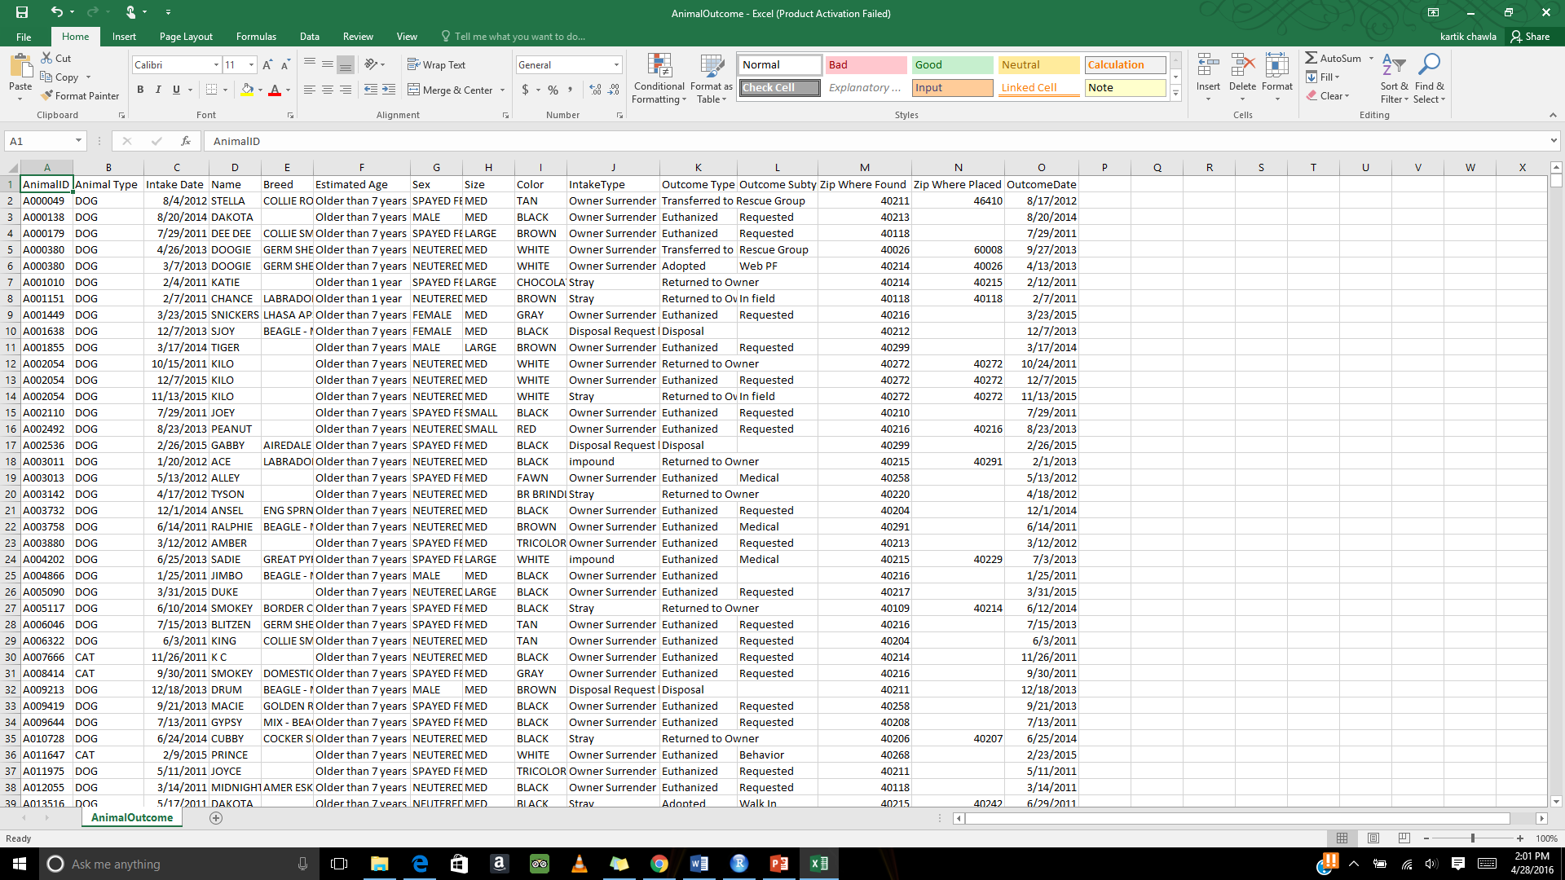

Slide 4
Descriptive Analytics
AnimalID: This is a 6 digit number preceded by an A. No Null
AnimalType: Dogs, Cats, Birds, Guinea pigs, Livestock, Rabbit and others. No Null
IntakeDate: The date the animal enters the shelter. Multiple date formats 2011-2015. No Null
Name: The name of the animal. String ~1/3 Null
Breed: The breed of the animal. String ~80% Null
EstimatedAge: String with options Infant < 6months, Youth < 1year, >1year, >7years. ~30% Null
SimAge: The age was randomly generated within the range provided by the EstimatedAge. Integer ~30% Null
Sex: String with options Male, Female, Spayed, Neutered, or Unknown. 300 Null

Slide 5
Size: String with options small, medium, large, xlarge, toy, puppy, or kitten. 878 Null
Color: String 7 Null
IntakeType: The reason the animal was brought into the shelter. String with options Disposal Request, For Transport, Foster Return, Impound, Out Patient, Owner Surrender, Reported Found, Reported Lost, Stray. No Null
OutcomeType: How the animal left the shelter. String 98 Null
OutcomeSubtype: The reason for the OutcomeType.String ~1/3 Null
ZipWhereFound: Integer Mostly between 40000-49999 863 Null
ZipWherePlaced: Integer ~50% Null
Outcome Date: Multiple date formats 2011-2015. No Null

Slide 6
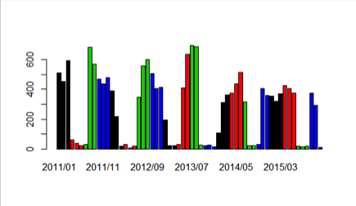
Graphs using r-studio
Graph for Strays per month for years from 2011 to 2015 colored by quarter

Slide 7
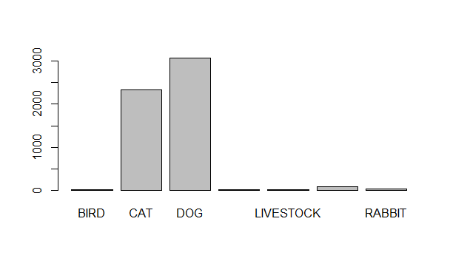

Graph for Adopted Animals by Animal Type

Slide 8
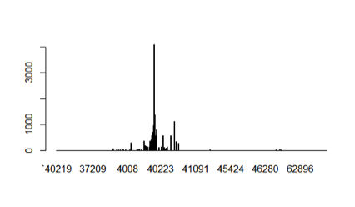
Graph for Stray Animals in every zip code

Slide 9
Predictive analysis
What factors are most useful in determining whether an animal will be adopted?
Determine which locations mostly have strays?
Predict the colour of animal and types of animal being most adopted
Predict age based on various attributes.

Slide 10
Challenges faced
The dataset, had unclear age of animals (column name: estimated age). On the basis of estimated age, we calculated the age of all the animals which were useful for us for all the analysis and prediction.
The zip code attributes have some blank data and some mistyped values. We have cleaned the data by removing incorrect values or correcting the data. Once incorrect data was removed, we ignored blank records.
The dates had various formats. We used Excel to format all the dates in the same way. This way we did set the format of dates as required for R functions.

Slide 11
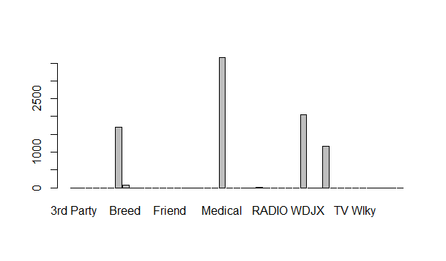
Euthanization of animals based on various reasons

Slide 12
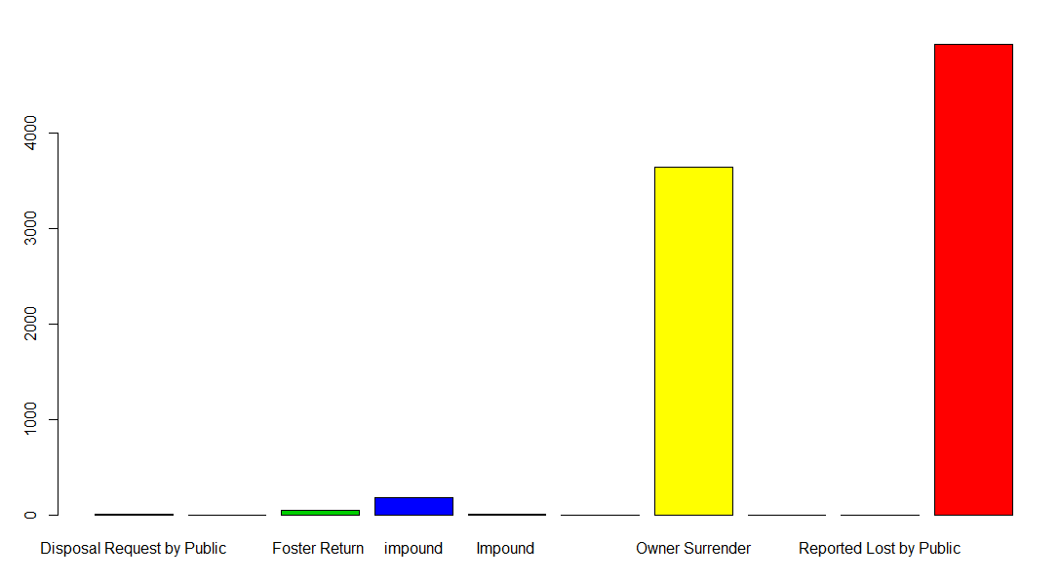
Euthanization based on Intake type

Slide 13
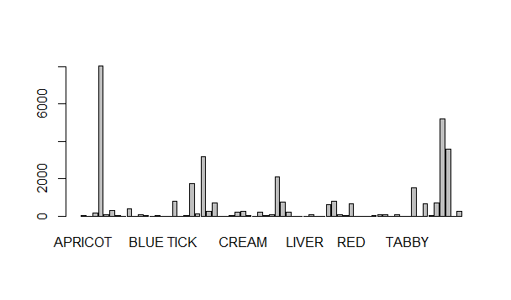
Which colored animal is adopted the most?
Color: Black- 8022

Slide 14
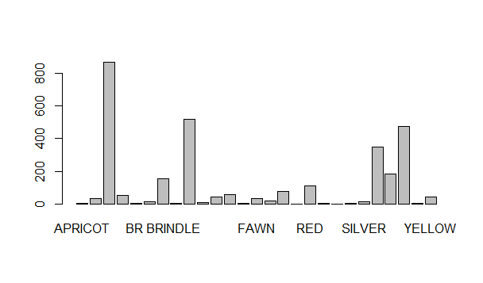
Which colored cat is most adopted?
Dog: Color- Black : 865

Slide 15
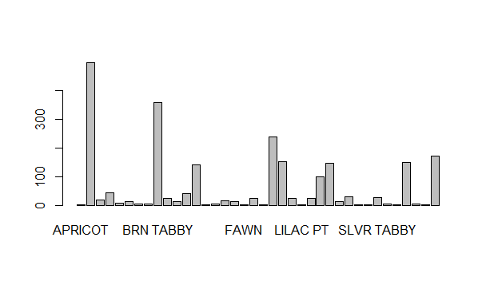
Which colored cat is adopted the most?
Color: Black- 496

Slide 16
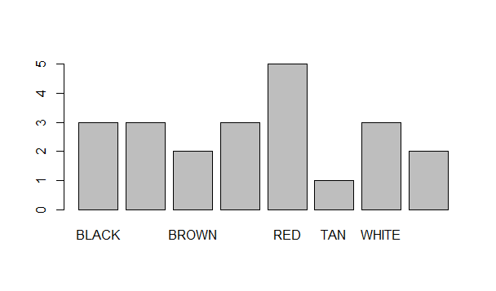
Which colored Bird is adopted the most?
Color: Red- 5

Slide 17
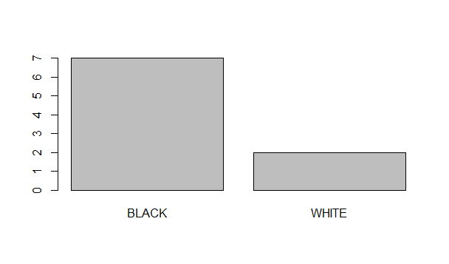
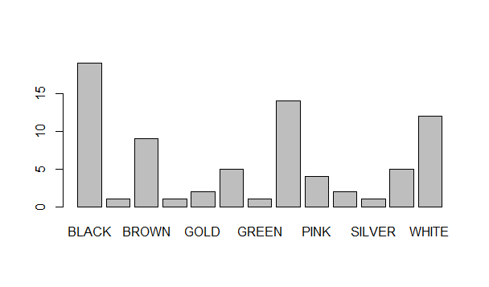
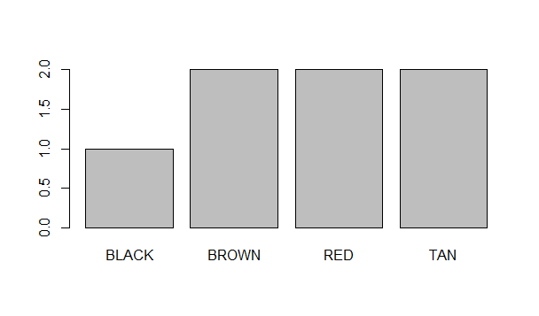
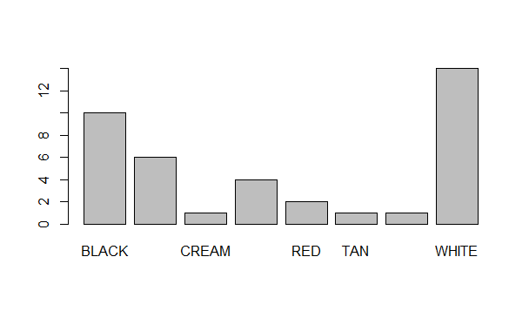
Similarly, for Livestock, Guinea pig and rabbit
Livestock Others
Pig Rabbit

Slide 18
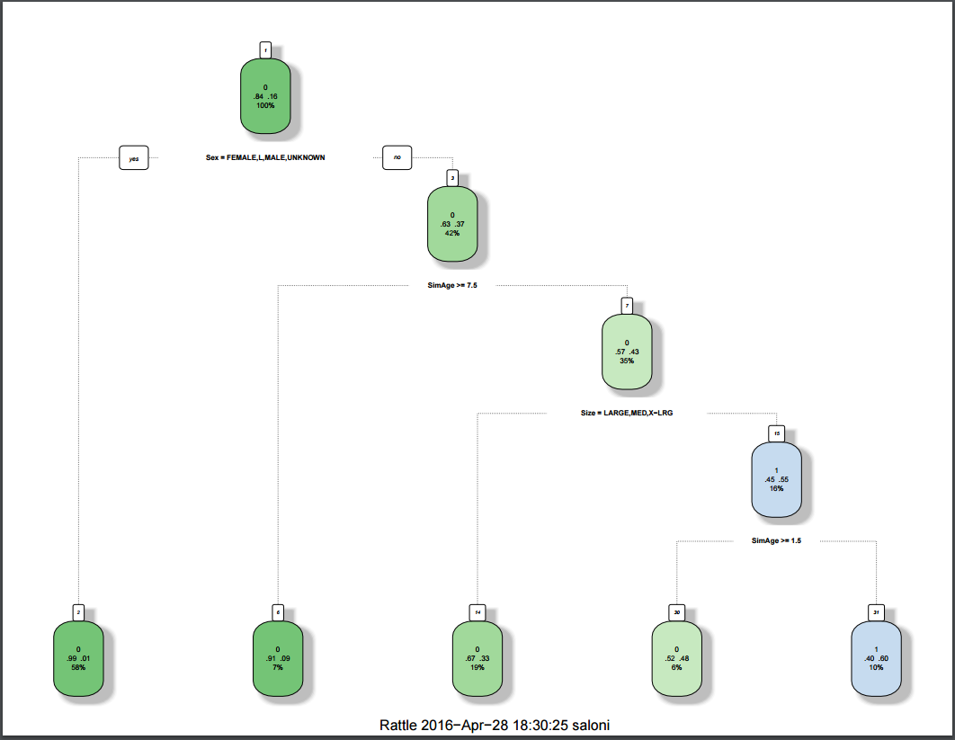
Adoption based on size,sex and age.

Slide 19
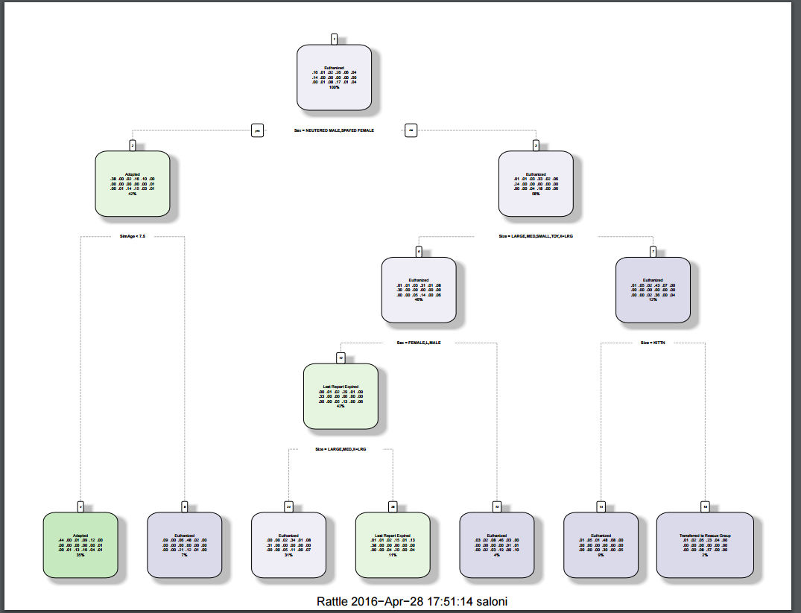
Outcometype based on size, sex & age

Slide 20
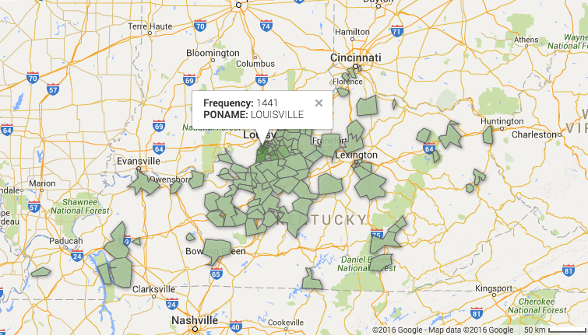
Stray dogs by zip

Slide 21
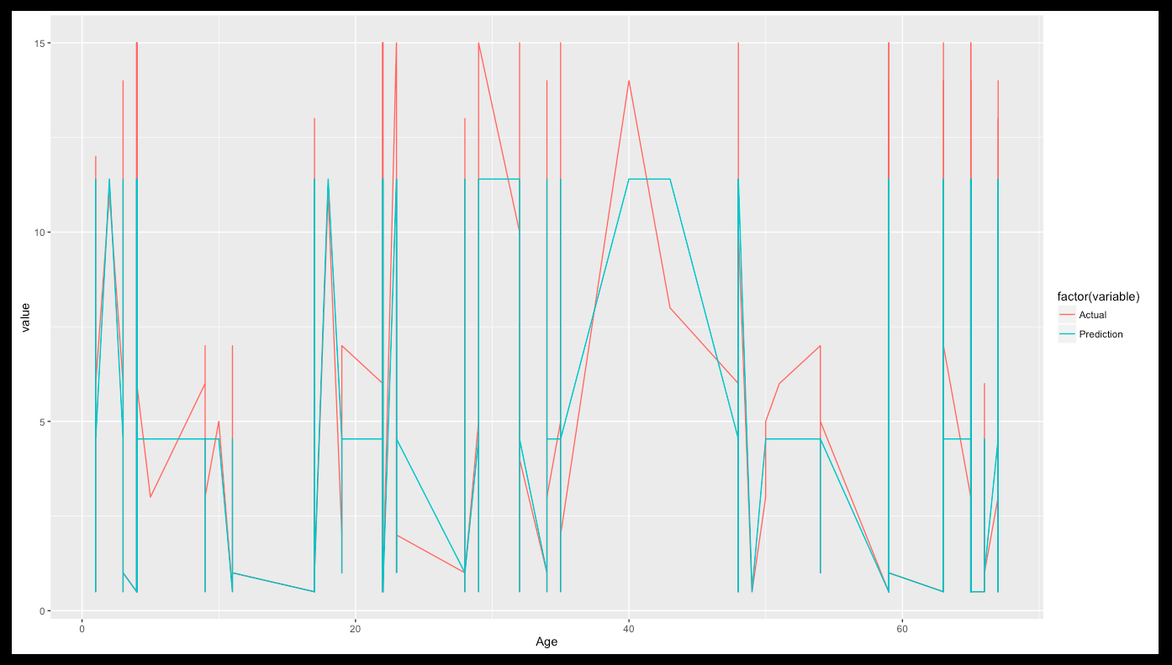
Age Prediction

